Slide 1
ELK Stack

Slide 2
ELK" is the acronym for three open source projects: Elasticsearch, Logstash, and Kibana.
Elasticsearch is a search and analytics engine.
Elasticsearch is a distributed, RESTful search and analytics engine capable of addressing a growing number of use cases. As the heart of the Elastic Stack, it centrally stores your data for lightning fast search, fine‑tuned relevancy, and powerful analytics that scale with ease.
https://www.elastic.co/what-is/elk-stack

Slide 3
Logstash is a server‑side data processing pipeline that ingests data from multiple sources simultaneously, transforms it, and then sends it to a "stash" like Elasticsearch.
Kibana lets users visualize data with charts and graphs in Elasticsearch.

Slide 4
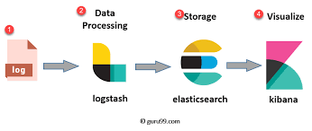

Slide 5
